Slide 1
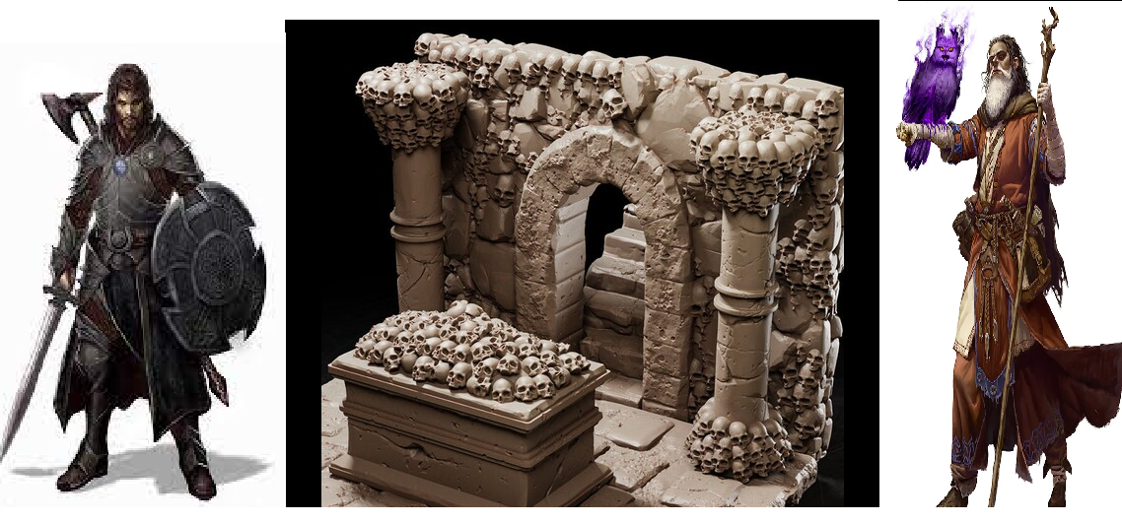
Underground Tactics
Pitch Date: April 7, 2024 Week 1
Release Date: July 28, 2024 30 Commits
Team Lead: Vince McKeown 1 Contributor
1
2
3
4
5
6
7
8
9
10
11
12
13
14
15
16
4/13/2024

Slide 2













Vince McKeown Commits
Code
Handle player options for spells, movement, items, and end turn.
Animation for player/objects
Sprite Sheet
Movement correction
Player Collisions for items

